Slide 1
Angular Upskilling Program
Http Client Module

Slide 2
Web applications types
When we are talking about web applications, there are two types that can distinguish them:
Static content web applications (that does not require any communication with the server and it will just render the static content defined in each component)
Dynamic content web applications (that will display the content from a content based on data fetching from a server)

Slide 3
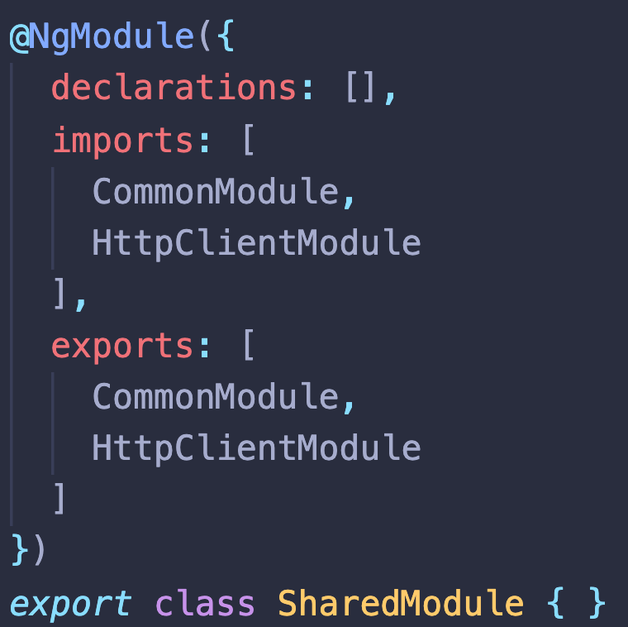
HttpClientModule
Angular does not use any third party libraries like axios or the standard fetch API and provides its own implementation for AJAX calls, that is strongly based on RxJS.
When an Angular application is created it does not offer this functionality out of the box, in order to keep the production bundle size as small as possible and only make it available if the developer decides to do this.
To enable the access to the HttpClient it must be imported in each NgModule imports property.
NOTE: Because the HttpClientModule will be used across all the modules from an application it
is recommended to create a SharedModule that will export the core used modules.

Slide 4
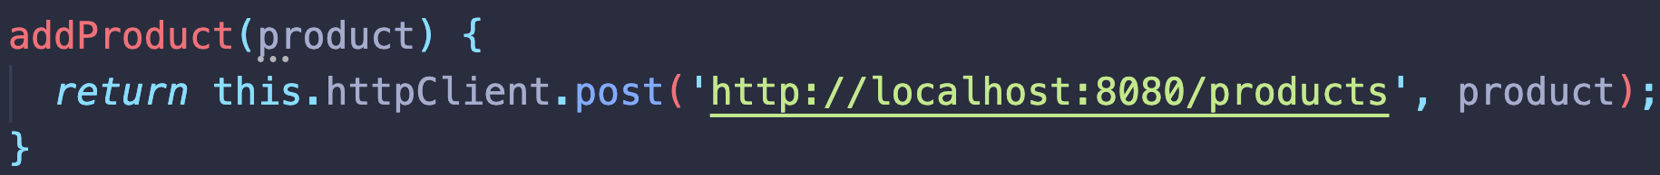
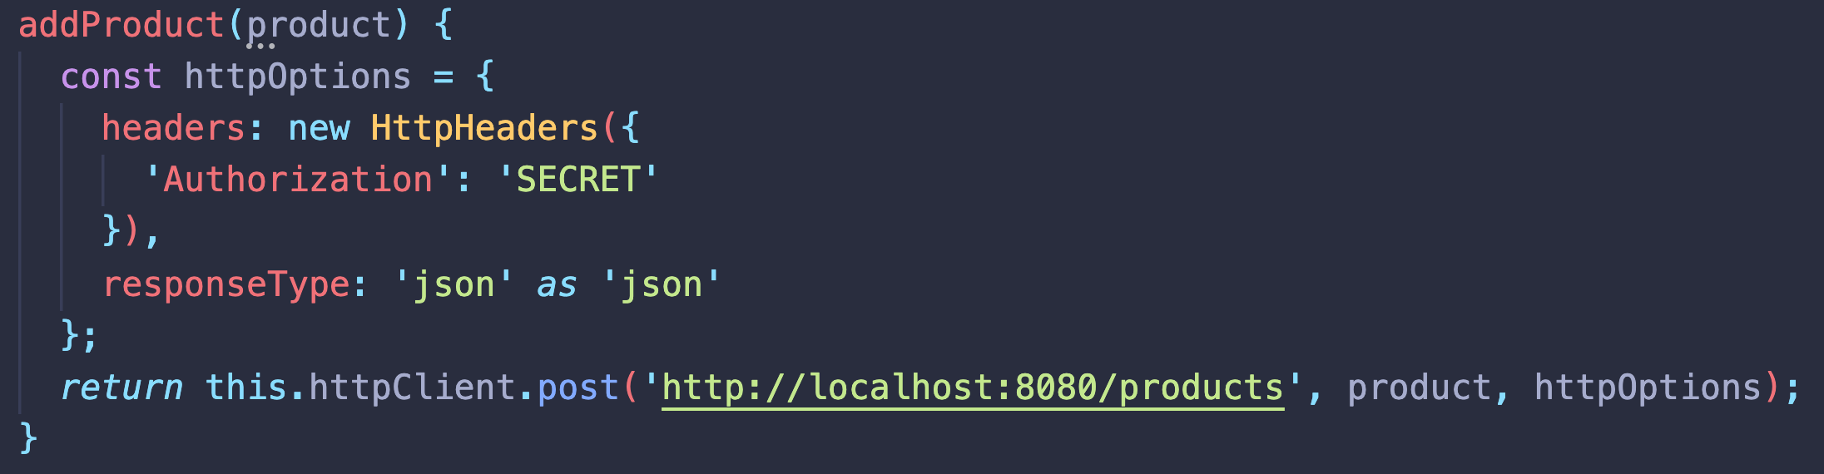
HttpClient
The HttpClientModule will act as a provider for the HttpClient service that contains the logic for all supported HTTP methods and iteractions with the application’s Networking.
How to use:
1. Inject the service in the constructor
2. Call the httpClient HTTP method (suggestively named)
3. If the method supports a request body pass it as an argument
4. If any additional options are needed to be passed such as Headers or Response Type a third argument is supported called httpOptions. Allowed values for responseType: arraybuffer, blob, json (default), text;

Slide 5
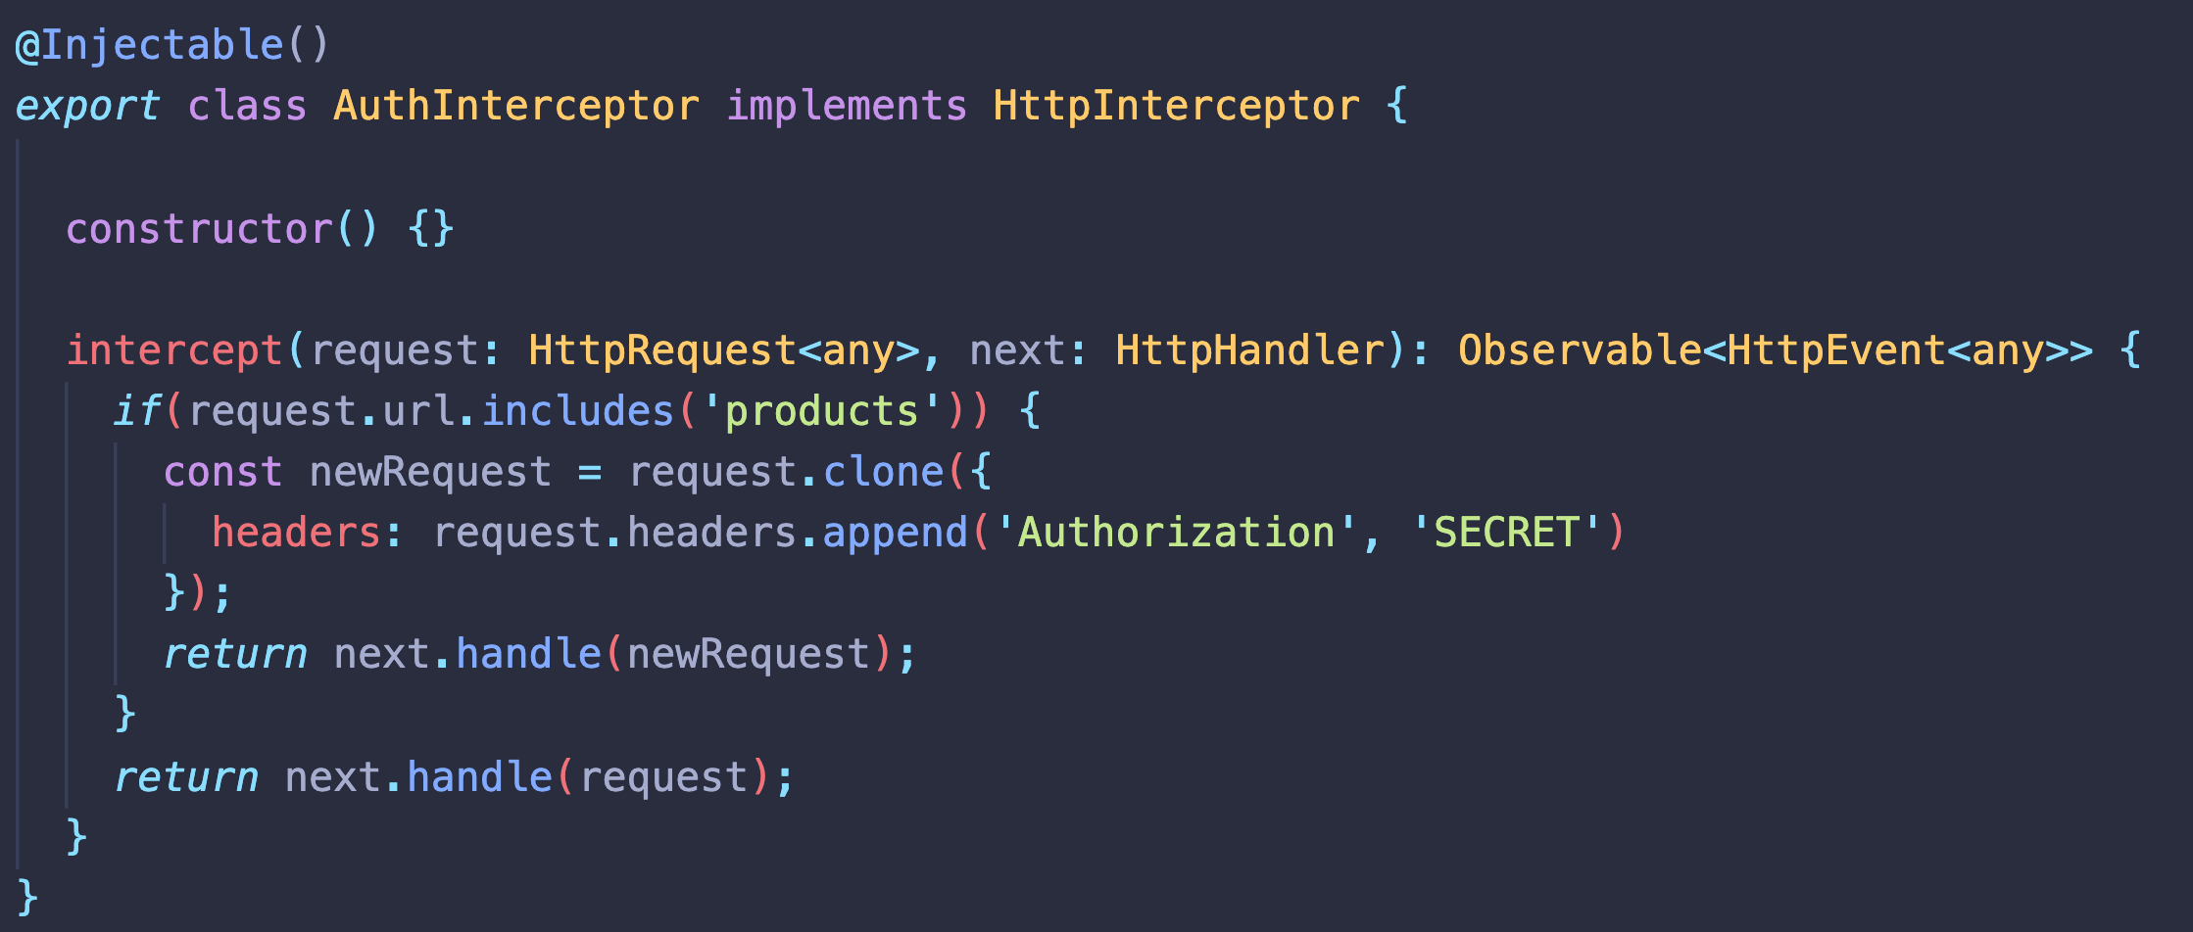
HttpInterceptors - Declaration
Interceptors can be used to alter the request before it is sent to the Server.
In order to implement the security model for an application it is usually needed to add the authentication token to each authorized request from the server side.

Slide 6
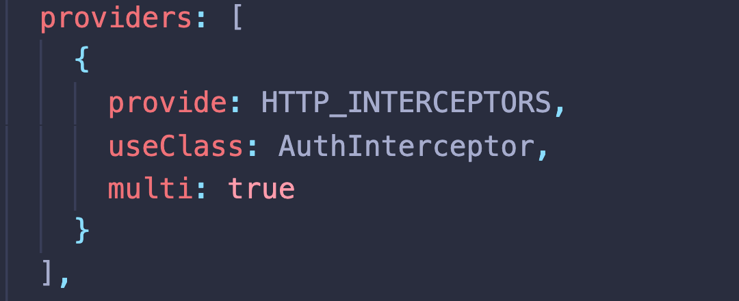
HttpInterceptors - Providers
As it can be noticed from the previous slide the Interceptor is a class decorated with the @Injectable() decorator. This should tell us that it needs a provider in order to be injected in the Dependency Injector.
provide: The injection token used by the Dependency Injector to return the array of interceptors;
useClass: Instance of the class that needs to be provided;
multi: flag needed to tell the injector that multiple interceptors can be injected in the application;

Slide 7
HttpInterceptor – Use Cases
Authentication;
Header Manipulation;
URL manipulation;
User Experience Interactions: Loaders / Notifications
Request body normalization;
Error handling;
Caching;
Profiling;

Slide 8
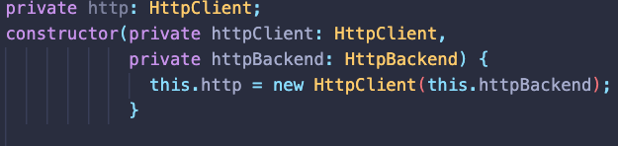
HttpBackend
There are cases where some of the requests sent to the method will have logic that cannot be handled by an interceptor:
Custom headers required;
No authentication token needed for the request;
No alteration of the request needed;
The solution is to use the HttpBackend dependency that will dispatch the requests directly to the server without being processed by the interceptor.

Slide 9
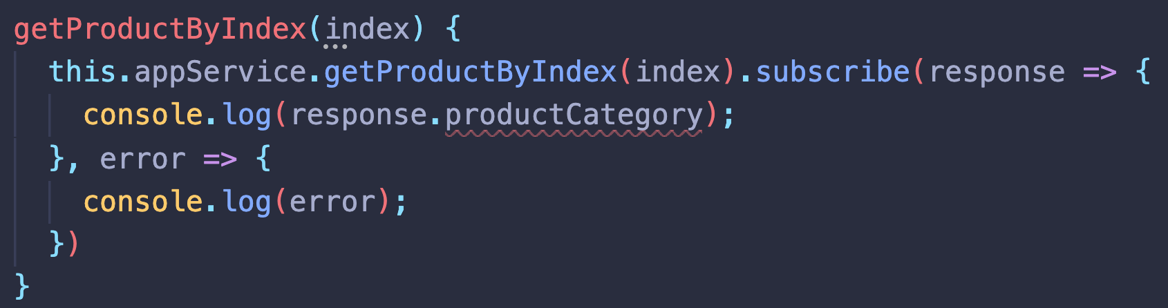
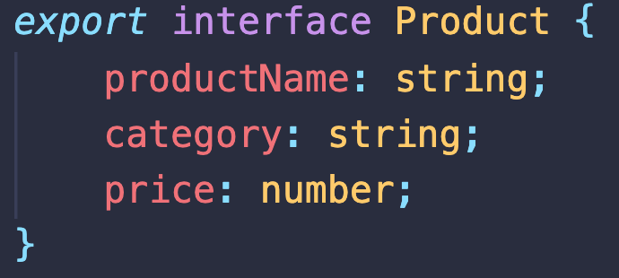
Response Type
By default Angular does not know what is the format of the response that comes from the server.
HttpClient method supports generics in order to tell Typescript compiler what kind of object is expected as a response:
NOTE: For this usecase Product is a Typescript Interface

Slide 10


